Slide 1
ROS 2 Logging Subsystem & rcl_logging_syslog
Tomoya Fujita
Sony Group Corporation

Slide 2


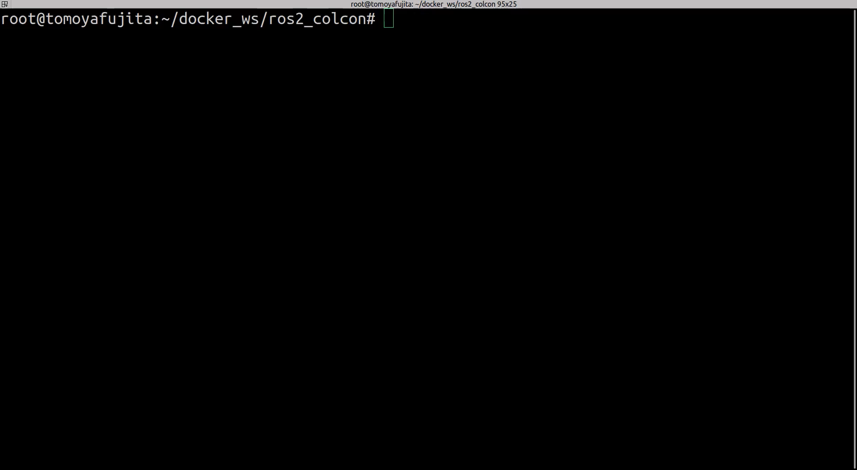
Who am I ?
Tomoya Fujita fujitatomoya@github
ROS Project Management Committee
ROS 2 core maintainer
OpenRobotics Google Summer of Code Mentor
ROSCon PC／OC／EC etc...
IEEE Robotics & Automation Practice Editorial Board
ROSCon 2024 Odense
ros2ai : next-gen ROS 2 CLI empowered by OpenAI and Ollama
KubeCon 2024
Applying Cilium at Edge with KubeEdge
CNCF
Edge Native Applications Principles Whitepaper
Edge Native Application Design Behaviors Whitepaper

Slide 3
ROS 2 Logging Subsystem Overview
ROS 2 provides a flexible and configurable logging subsystem.
Supports multiple logging backends.
stdout: Logs are printed to the standard output (default ON to console)
rosout: Logs are published to the /rosout topic (default ON)
external: Default spdlog, or your own implementation.
ROS 2 app(cpp)
ROS 2 app(python)
rclcpp
rclpy
rcutils (log level hash map)
rcl
rosout
rcl_logging_interface
rcl_logging_spdlog
rmw
spdlog
stdout

Slide 4
Enabling and Disabling Logging Backends
Node option in the program (e.g rclcpp::NodeOptions)
Be advised that NodeOption only support rosout
rclpy also supports the option to disable rosout.
Global ROS arguments via CLI. (can be overridden by NodeOptions)
# Disabling rosout log publisher
$ ros2 run foo_pkg bar_exec --ros-args --disable-rosout-logs
# Disabling console output
$ ros2 run foo_pkg bar_exec --ros-args --disable-stdout-logs
# Disable any external loggers
$ ros2 run foo_pkg bar_exec --ros-args --disable-external-lib-logs

Slide 5
Logging Severity Level
DEBUG, INFO, WARN, ERROR and FATAL.
A logger will only process log messages with severity at or higher than a specified level chosen for the logger.
Logger names represent a hierarchy.
If the level of a logger named abc.def is unset, it will defer to the level of its parent named abc, and if that level is also unset, the global default logger level will be used. When the level of logger abc is changed, all of its descendants (e.g. abc.def, abc.ghi.jkl) will have their level impacted unless their level has been explicitly set.

Slide 6
Set Logging Level via ros2run
# configures the default severity for any unset logger to the debug severity level
$ ros2 run logging_demo logging_demo_main --ros-args --log-level debug
# configures the severity for specific logger (node)
$ ros2 run logging_demo logging_demo_main --ros-args --log-level logger_usage_demo:=debug

Slide 7
Logging Level Configuration Service
It allows user to set the logging level of node at runtime.
Use rclcpp::NodeOptions().enable_logger_service(true) (default false)
See more details for Logger level configuration: externally
ROS 2
talker
request
$ ros2 service list
...
/NodeWithLoggerService/get_logger_levels
/NodeWithLoggerService/set_logger_levels
...
response
ROS 2
listener
response
request

Slide 8
What else can we do?
…
stamp:
sec: 1758182455
nanosec: 534956691
level: 20
name: talker
msg: 'Publishing: ''Hello World: 27'''
file: /root/ros2_ws/colcon_ws/src/ros2/demos/demo_nodes_cpp/src/topics/talker.cpp
function: operator()
line: 47
…
Change console output format and color.
E.g) file name, line number, different format for timestamp…
`ros2 topic echo /rosout` to see logging data in live
Set the log file name prefix.
Logging Environmental Variables
ROS_LOG_DIR : Control the logging directory that is used for writing logging messages to disk.
RCUTILS_LOGGING_USE_STDOUT : Control what stream output messages go to. If this is unset or 0, use stderr. If this is 1, use stdout.
…
$ ros2 run demo_nodes_cpp talker --ros-args --log-file-name filename

Slide 9
Questions / Problems
How do we manage hundreds and thousands robots log data?
I want to receive the event if critical error happens.
Entire system observability.
Individual logging level for different logging pipeline.
Configure log behavior without any code change.
Log data pipeline and forward capability support.
I also want to collect Non-ROS application system log all together.

Slide 10

rcl_logging_syslog
Alternate implementation for rcl_logging_interface
ROS 2 rcl logging implementation built on top of syslog(3)
Connects with rsyslog and FluentBit etc...

Slide 11
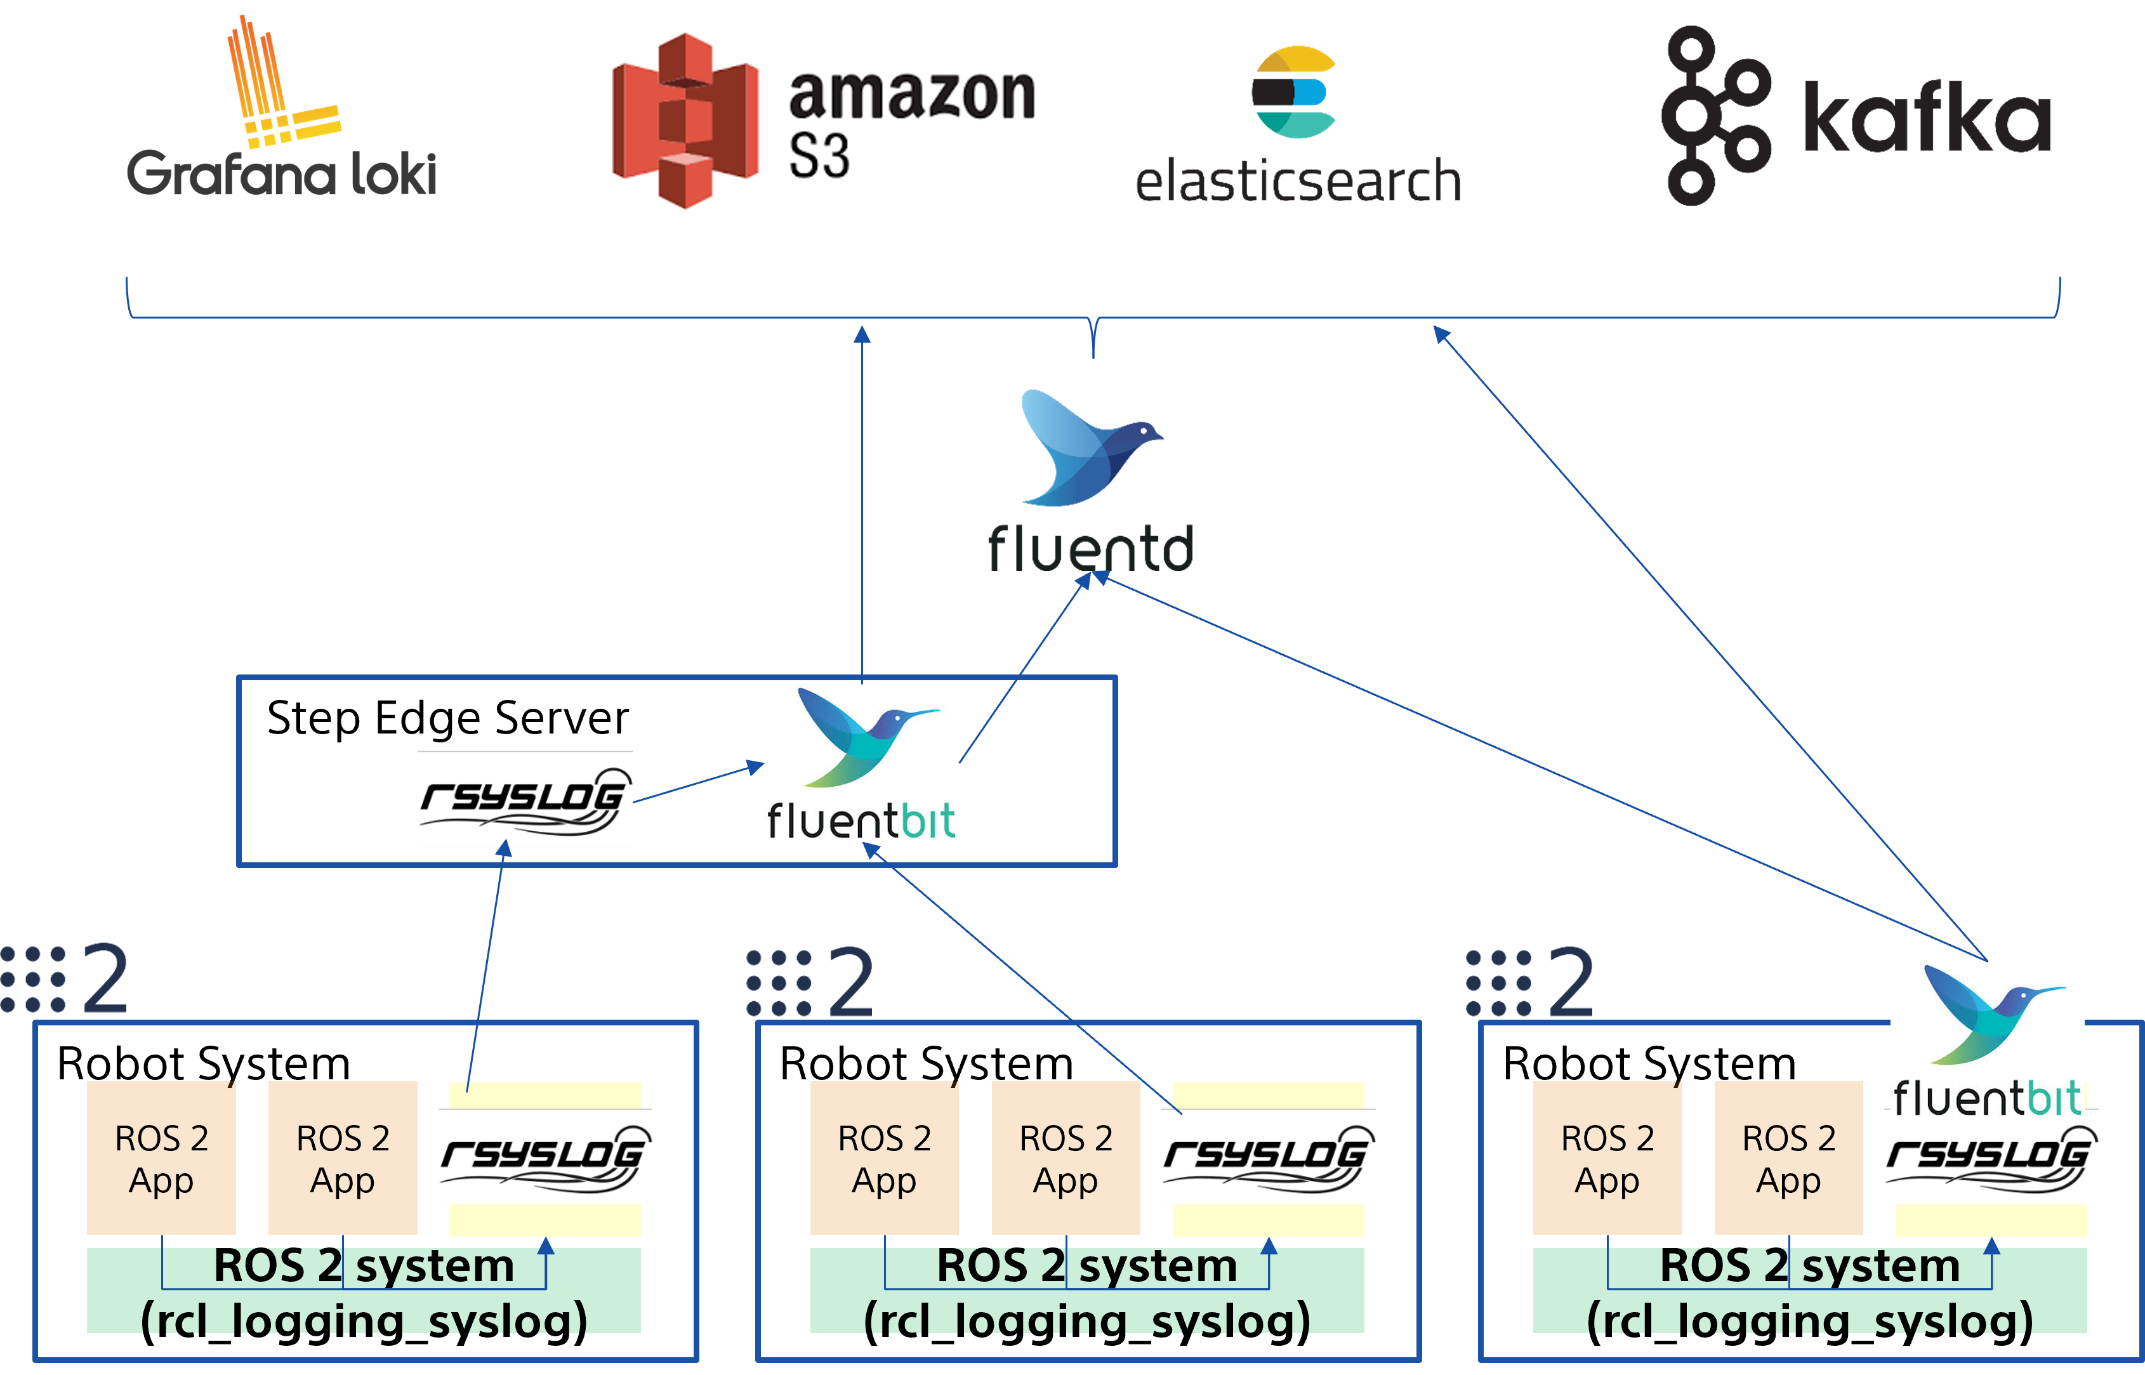
Architecture

Slide 12
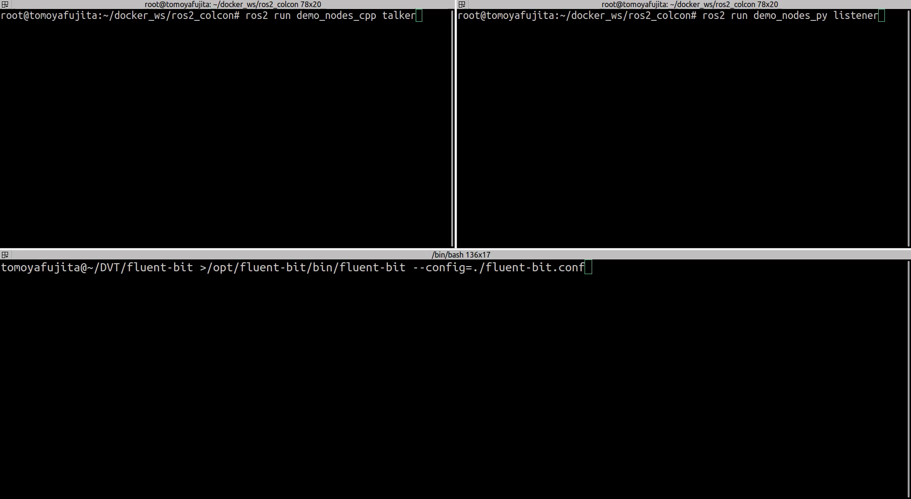

Slide 13
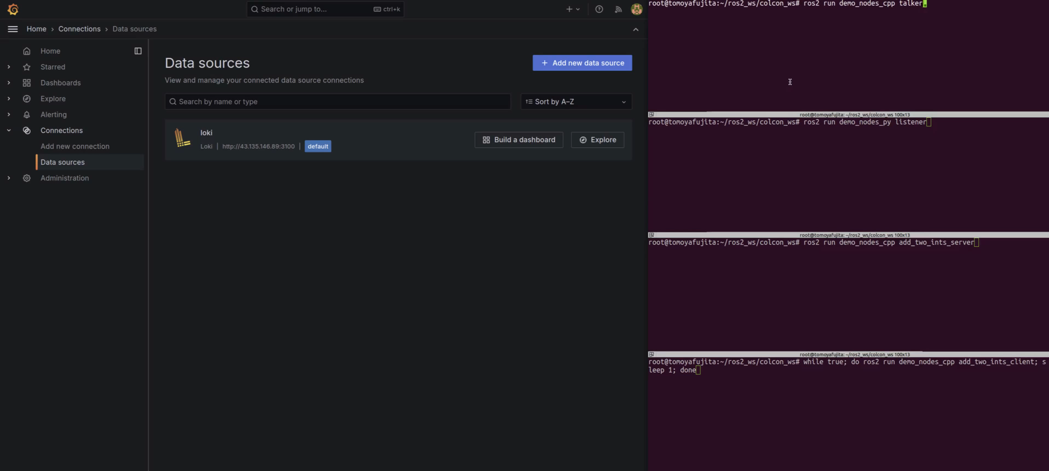

Slide 14




Supported Distribution

Slide 15
rsyslog
a.k.a rocket-fast system for log processing 🚀🚀🚀
rsyslog is available in default Ubuntu distribution managed by system service, performative, and many configuration supported including log data pipeline.
So that user can choose the logging configuration depending on the application requirement and use case, sometimes file system sink, sometimes forwarding to remote rsyslogd, or even FluentBit.

Slide 16

FluentBit
Lightweight and Efficient
suitable for environments with limited computational power.
High Performance
capable of handling high-volume data streams with minimal latency. It leverages asynchronous I/O and efficient data processing techniques to ensure optimal performance.
Flexibility
supports a wide range of data sources and destinations.
Extensibility
highly extensible through plugins including custom ones.
Scalability
easily scaled horizontally to handle increasing data volumes by deploying multiple instances.
Reliability
features like fault tolerance and retry mechanisms to ensure data reliability.

Slide 17
How to use
export RCL_LOGGING_IMPLEMENTATION=rcl_logging_syslog
colcon build --symlink-install --cmake-clean-cache --packages-select rcl_logging_syslog rcl
If you use docker, either binding -v /dev/log:/dev/log or enable rsyslogd in the container.
See more details for Installation Tutorial

Slide 18
Future Plan
Package is not available yet, because…
rcl_logging_interface implementation must be build and integrated with rcl binary. That says, we cannot change the rcl logging implementation at runtime without rebuilding the source code. This needs to be fixed Feature Request: Select the logger without rebuilding
ROS app
ROS app
ROS app
ROS app
rcl
rcl
rcl_logging_interface
rcl_logging_interface
rcl_logging_spdlog
rcl_logging_spdlog
rcl_logging_syslog
spdlog
spdlog
rsyslog

Slide 19
Issues and PRs always welcome 🚀
source code, documentation, presentation slides, everything is here.
https://github.com/fujitatomoya/rcl_logging_syslog

